Slide 1
Chapter: Introduction & Operating-System Structures NARZU TARANNUM (NAT) LECTURER DEPT. OF CSE, BRAC UNIVERSITY

Slide 2
Information of Course Teachers
Dr. Amitabha Chakrabarty <amitabha@bracu.ac.bd>
Narzu Tarannum <narzu.tarannum@bracu.ac.bd>
Faisal Bin Ashraf <faisal.ashraf@bracu.ac.bd>
Md Tanzim Reza <tanzim.reza@bracu.ac.bd>
Mostafijur Rahman Akhond <mostafij.akhond@bracu.ac.bd>
Afrina Khatun <afrina.khatun@bracu.ac.bd>
Ehsanul Kabir <ehsanul.kabir@bracu.ac.bd>

Slide 3
Recommended Text book
Silberschatz, Peter B. Galvin, Greg Gagne, "Operating System Concepts", Wiley; 9th edition (2009) ISBN: 978-1-118-06333-0

Slide 4
Course Outline
Operating Systems Overview and Structures
Processes Management
CPU Scheduling
Threads
Process Synchronization
Deadlocks
Memory Management/ Main memory
Virtual Memory
Mass-Storage structure

Slide 5
Objectives
To provide a grand tour of the major operating systems components
To provide coverage of basic computer system organization
To describe the services an operating system provides to users, processes, and other systems
To discuss the various ways of structuring an operating system

Slide 6
Content of this chapter
What Operating Systems Do
Computer-System Organization
Computer-System Architecture
Operating-System Structure
Operating-System Operations
Storage Structure
System call
Protection and Security
Operating systems Services

Slide 7
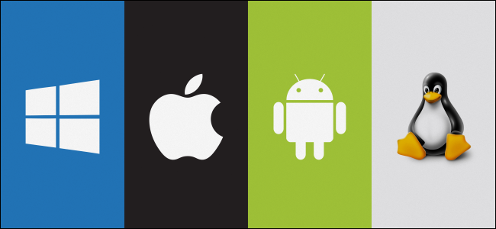
What is an Operating System?
A program that acts as an intermediary between a user of a computer and the computer hardware
Operating system goals:
Execute user programs and make solving user problems easier and make the computer system convenient to use.
Use the computer hardware in an efficient manner.

Slide 8
What is an Operating Systems do?
It works between users and computer hardware.
Resource allocator – manages and allocates resources.
Control program – controls the execution of user programs and operations of I/O devices .
Kernel – the one program running at all times (all else being application programs).
The kernel is the central module of an operating system (OS). It is the part of the operating system that loads first, and it remains in main memory. The kernel code is usually loaded into a protected area of memory to prevent it from being overwritten by programs or other parts of the operating system.

Slide 9
Primary Functions of an OS
Processes-management
Storage-memory management
Data-file management
Input/output devices-i/o management
Network management
Protection& security

Slide 10
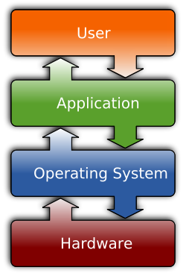
Software
The two most common types of software are :
System software
Application software.
What is System Software?
System Software refers to the operating system and all utility programs that manage computer resources at a low level. Systems software includes compilers, loaders, linkers, and debuggers.
What is Application Software?
Applications software comprises programs designed for an end user, such as word processors, database systems, and spreadsheet programs.

Slide 11
Computer System Structure
Computer system can be divided into four components
Hardware – provides basic computing resources
CPU, memory, I/O devices
Operating system
Controls and coordinates use of hardware among various applications and users
Application programs – define the ways in which the system resources are used to solve the computing problems of the users
Word processors, compilers, web browsers, database systems, video games
Users
People, machines, other computers

Slide 12
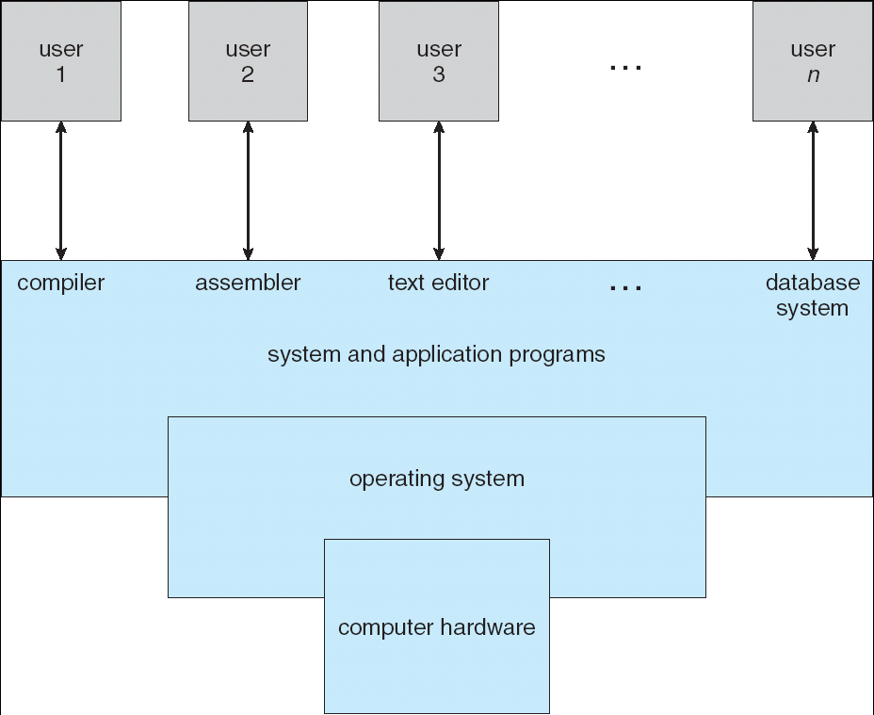
Four Components of a Computer System

Slide 13
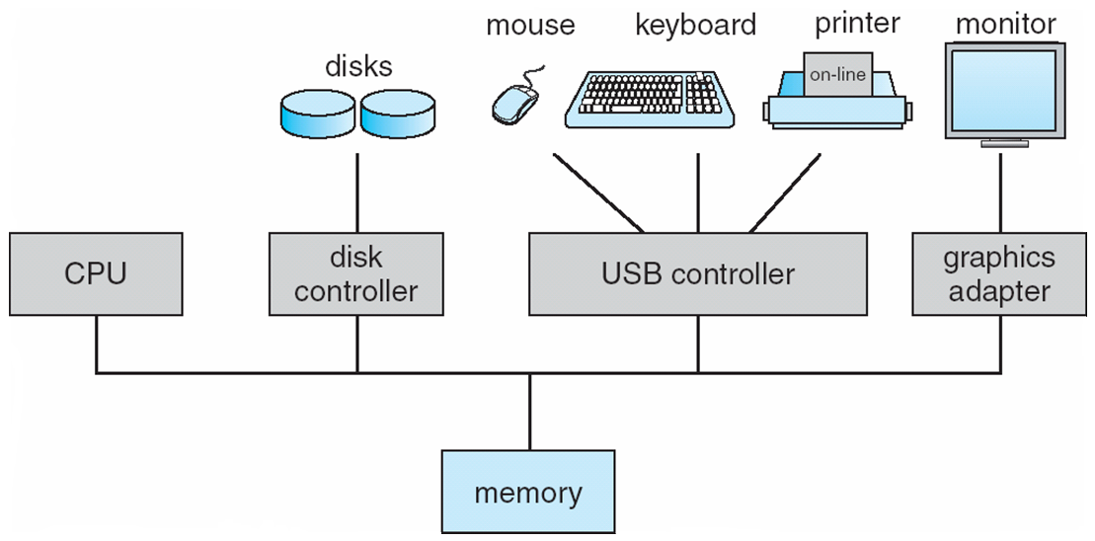
Computer System Organization
Computer-system operation
One or more CPUs, device controllers connect through common bus providing access to shared memory
Concurrent execution of CPUs and devices competing for memory cycles.
To ensure orderly access to the shared memory, a memory controller is provided whose function is to synchronize action to the shared memory.

Slide 14
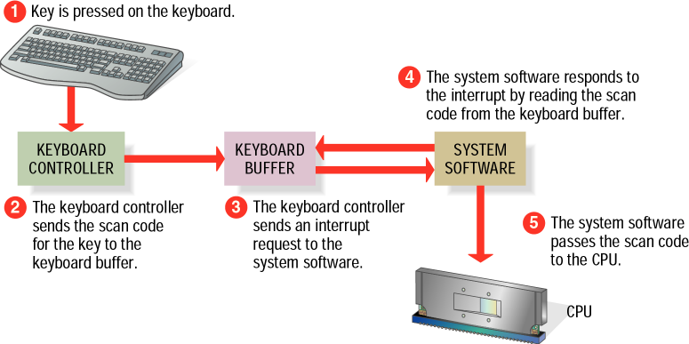
Computer-System Operation
I/O devices and the CPU can execute concurrently.
Each device controller is in charge of a particular device type.
Each device controller has a local buffer. [store (data) in a buffer while it is being processed or transferred.]
CPU moves data from/to main memory to/from local buffers
Device controller informs CPU that it has finished its operation by causing an interrupt.
Notes:
store (data) in a buffer while it is being processed or transferred.
store (data) in a buffer while it is being processed or transferred.
store (data) in a buffer while it is being processed or transferred.
store (data) in a buffer while it is being processed or transferred.

Slide 15
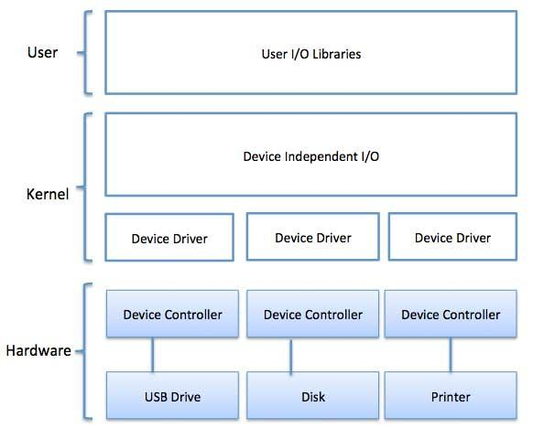
Device driver and Device controller
Operating System has a device driver for each device controller.
Device driver understand the device controller and provide a uniform interface
Notes:
Device Driver for each device controller to manage I/O Provides uniform interface between controller and kernel.

Slide 16
Computer Startup
bootstrap program is loaded at power-up or reboot
Typically stored in ROM or EPROM, generally known as firmware
Initializes all aspects of system
Loads operating system kernel and starts execution

Slide 17
Operating-System Operations
An Operating system is Interrupt driven
Hardware interrupt
Occurs by one of the devices
Software interrupt (exception or trap)
Request for operating system service
Software error (e.g., division by zero)
A trap is a software-generated interrupt caused either by an error or a user request.

Slide 18
Common Functions of Interrupts
Interrupts transfers control to the interrupt service routine generally, through the interrupt vector, which contains the addresses of all the service routines.
Interrupt architecture must save the address of the interrupted instruction.

Slide 19
TO UNDERSTAND WHAT OS ARE, WE MUST FIRST UNDERSTAND HOW THEY HAVE DEVELOPED.

Slide 20
History of OS / Types of OS
Simple Batch Systems
Multiprogramming Systems
Time-Sharing Systems
Parallel Systems
Distributed Systems
Real -Time Systems

Slide 21
History of OS/ Types of OS
Simple Batch Systems: Automatically transfers control from one job to another.
Multi-programmed Batched Systems: Several jobs are kept in main memory at the same time, and the CPU is multiplexed among them.
Time Sharing Systems: Logical extension of multiprogramming.
Parallel Systems: Multiprocessor systems with more than one CPU
Distributed Systems: Distribute the computation among several physical processors.
Loosely coupled system – each processor has its own local memory; processors communicate with one another through various communications lines, such as high-speed buses or telephone lines.
Real-time Systems: Often used as a control device in a dedicated application such as controlling scientific experiments, medical imaging systems, industrial control systems, and some display systems.

Slide 22
Simple Batch Systems
Automatically transfers control from one job to another.
Common input-output device are card readers and tape drivers.
User prepare a job which consisted of program, input data and control instructions.
Computer
Memory
CPU
Input
Output
OS
User program

Slide 23
Limitations of Simple Batch Systems
Not interactive
Memory is limited
CPU utilization is poor
Speed mismatch between I/O device and CPU

Slide 24
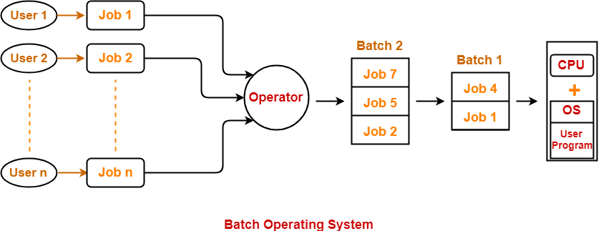
Simple Batch Systems
User prepares his job on an off-line device like punch cards and submits it to the computer operator. To speed up processing, jobs with similar needs are batched together and run as a group.
Advantages-
It saves the time that was being wasted earlier for each individual process in context switching from one environment to another environment.
No manual intervention is needed.
Disadvantages
Executing a series of non-interactive jobs all at one time.
The output is obtained only after all the jobs are executed.
Thus, priority can not be implemented if a certain job has to be executed on an urgent basis.

Slide 25
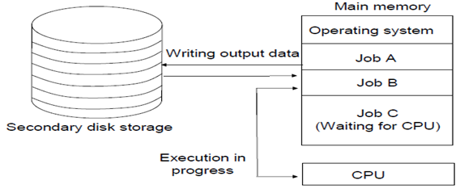
Multi-programmed Operating Systems
Multiprogramming needed for efficiency or maximize CPU utilization.
Multiprogramming means more than one process in main memory which are ready to execute.
Single user cannot keep CPU and I/O devices busy at all times
Multiprogramming organizes jobs (code and data) so CPU always has one to execute
A subset of total jobs in system is kept in memory
Process generally require CPU time and I/O time, when CPU has to wait (for I/O for example), OS switches to another job and this idea will continue.

Slide 26
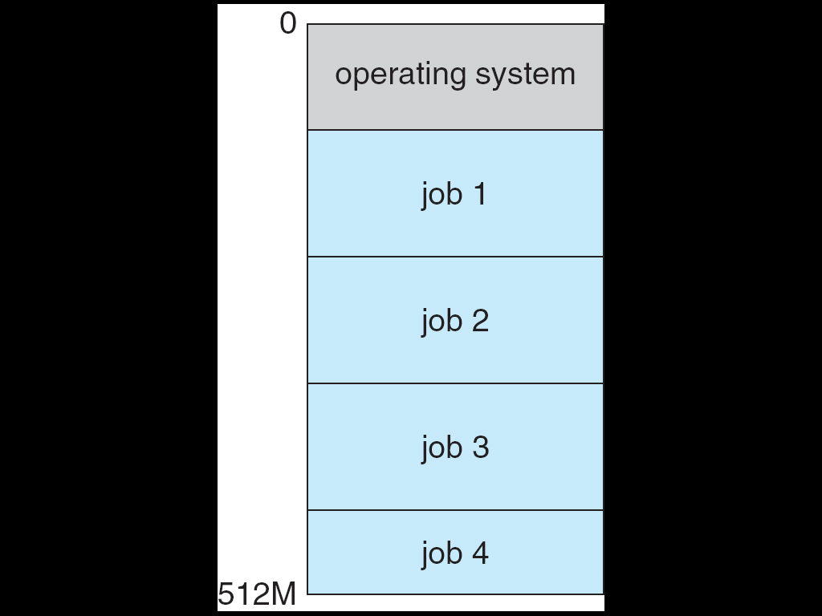
Multi-programmed Operating System
Several jobs are kept in main memory at the same time, and the CPU is multiplexed among them.
Advantages
High CPU utilization.
It appears that many programs are allotted CPU almost concurrently.
Response time is shorter
Disadvantages
CPU scheduling is required.
To accommodate several jobs in memory, memory management is essential.
Multi-programmed systems provide an environment in which the various system resources(like CPU, memory and peripheral devices) are utilized effectively but they do not provide for user interaction with the computer system.

Slide 27
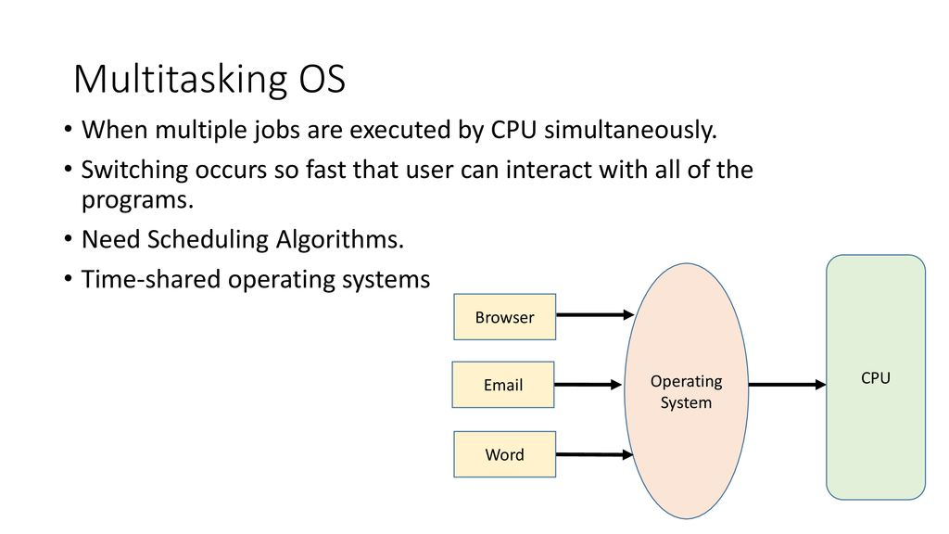
Multitasking/Time-Sharing Systems–Interactive Computing
Multitasking is multiprogramming with time sharing where CPU executes multiple jobs by switching among them.
Timesharing (multitasking) is logical extension of multiprogramming, in which CPU switches jobs so frequently that users can interact with each job while it is running, creating interactive computing.
The operating system is able to keep track of where you are in these tasks and go from one to the other without losing information.
Response time should be < 1 second
Time sharing requires an interactive(or hands-on)computer system, which provides direct communication between the user and the system.
A time-shared OS allows many users to share the computer simultaneously.

Slide 28
Multitasking/Time-Sharing Systems–Interactive Computing
Each user has at least one separate program for executing in memory.
A program loaded into memory and executing is called a ⇨process
⇨ Job scheduling
⇨ CPU scheduling
If processes don’t fit in memory, swapping moves them in and out to run from main memory achieving this goal is virtual memory.

Slide 29
Computer-system Architecture
Single-processor Systems: If there is only one general purpose CPU, then the system is a single-processor system.
Other special purpose processors are also present which perform device specific task.

Slide 30
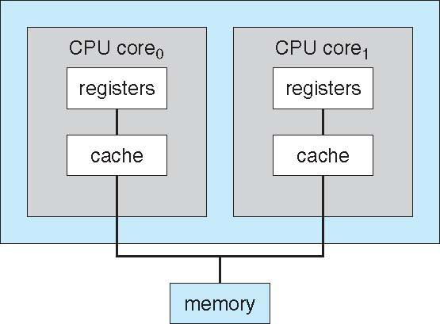
Computer-system Architecture
Multiprocessor Systems/Parallel System: Multiprocessor systems with more than one CPU in close communication.
Tightly Coupled System: processors share memory and a clock; communication usually takes place through the shared memory.
HAVE THREE MAIN ADVANTAGES :-
INCREASED THROUGHPUT
ECONOMY OF SCALE
INCREASED RELIABILITY

Slide 31
Multiprocessor Systems/Parallel System
Two Types:
Symmetric Multiprocessing(SMP):
Each processor runs an identical copy of the operating system.
Most modern operating systems support SMP.
Asymmetric Multiprocessing:
Each processor is assigned a specific task; master processor schedules and allocates work to slave processors

Slide 32
Two Types
Symmetric Multiprocessing Architecture Example
Asymmetric Multiprocessing Architecture Example
Master CPU
CPU 1
OS
P1
P2
P3
CPU 2
Slave CPU 1
Slave CPU 2
Slave CPU 3
CPU 3
P1
P2
P3

Slide 33
Distributed Systems and Real-time Systems
Distributed Systems: Distribute the computation among several physical processors.
Loosely coupled system – each processor has its own local memory; processors communicate with one another through various communications lines, such as high-speed buses or telephone lines.
Real-time Systems: Often used as a control device in a dedicated application such as controlling scientific experiments, medical imaging systems, industrial control systems, and some display systems.

Slide 34
Storage Structure
Main memory – only large storage media that the CPU can access directly
Random access
Typically volatile
Secondary storage – extension of main memory that provides large nonvolatile storage capacity

Slide 35
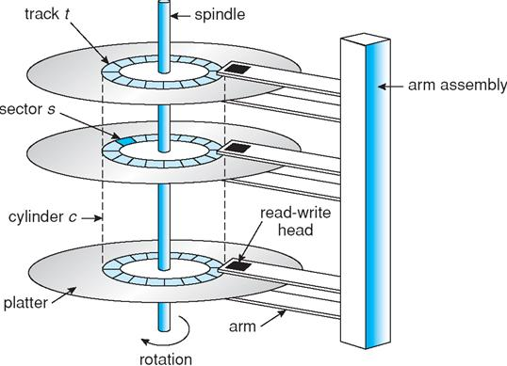
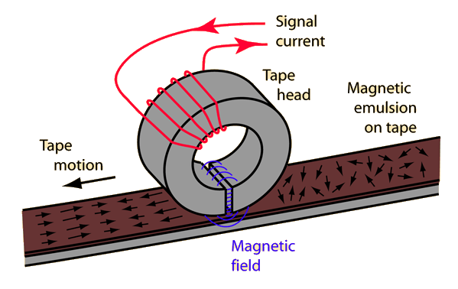
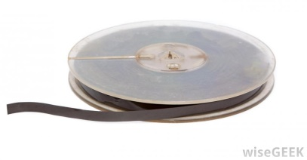
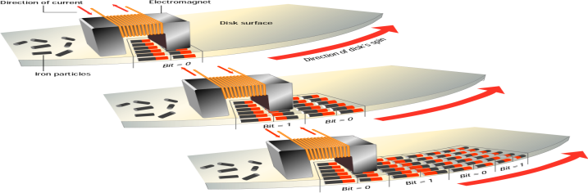
Storage Structure
Hard disks – rigid metal or glass platters covered with magnetic recording material
Disk surface is logically divided into tracks, which are subdivided into sectors
The disk controller determines the logical interaction between the device and the computer
Solid-state disks – faster than hard disks, nonvolatile
Various technologies
Becoming more popular
Magnetic Tapes

Slide 36
Caching
Important principle, performed at many levels in a computer (in hardware, operating system, software)
Information in use copied from slower to faster storage temporarily
Faster storage (cache) checked first to determine if information is there
If it is, information used directly from the cache (fast)
If not, data copied to cache and used there
Cache smaller than storage being cached
Cache management important design problem
Cache size and replacement policy

Slide 37
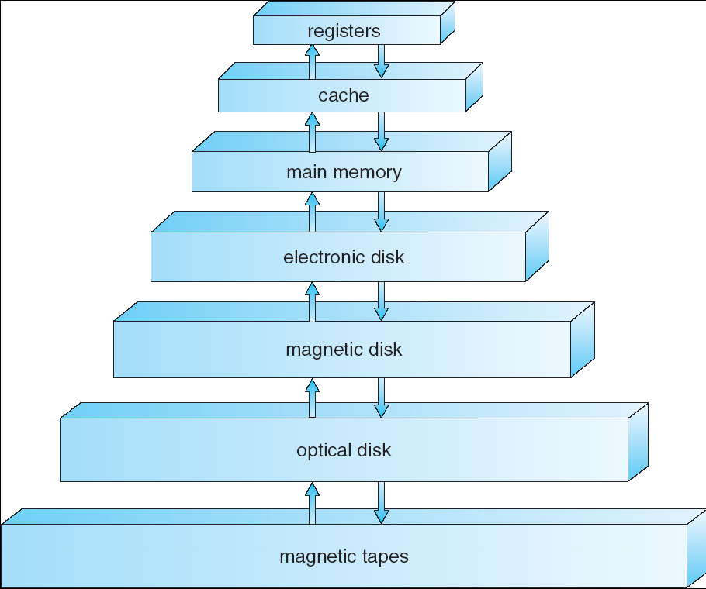
Storage-Device Hierarchy

Slide 38
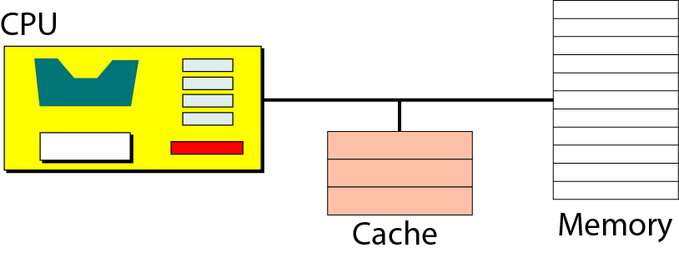
Storage Hierarchy
Storage systems organized in hierarchy.
Size
Speed (Access time)
Cost
Volatility
Caching – Information in use copied from slower to faster storage temporarily

Slide 39
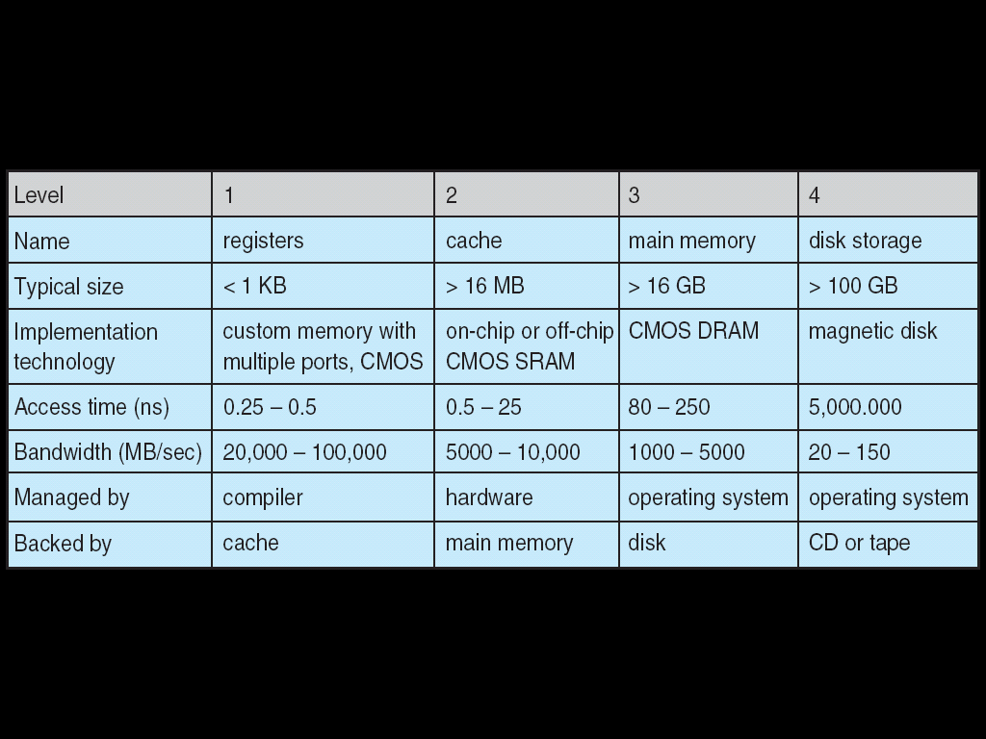
Performance of Various Levels of Storage
Movement between levels of storage hierarchy can be explicit or implicit

Slide 40
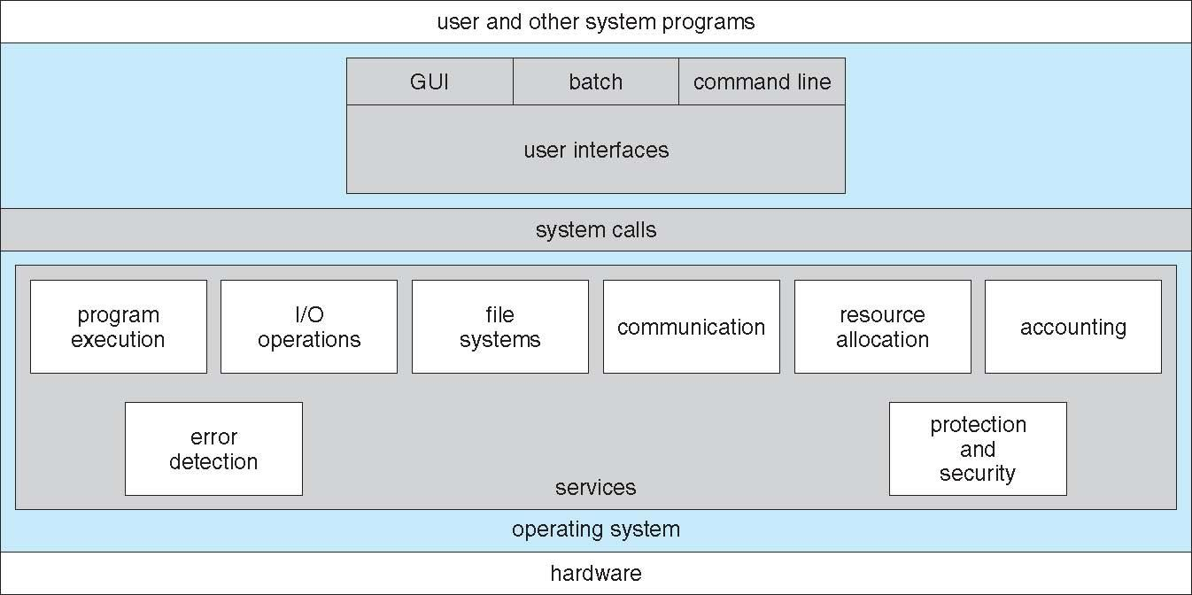
A View of Operating System Services

Slide 41
Operating System Services
User interface
Program execution
I/O operations
File-system manipulation
Communications
Error detection
Resource allocation
Accounting
Protection and security

Slide 42
Operating System Services
Operating systems provide an environment for execution of programs and services to programs and users
One set of operating-system services provides functions that are helpful to the user:
User interface - Almost all operating systems have a user interface (UI).
Varies between Command-Line (CLI), Graphics User Interface (GUI), Batch interface- in which commands and directives to control those commands are entered into files, and those files are executed.
Program execution - The system must be able to load a program into memory and to run that program, end execution, either normally or abnormally (indicating error)
I/O operations - A running program may require I/O, which may involve a file or an I/O device

Slide 43
Operating System Services (Cont.)
One set of operating-system services provides functions that are helpful to the user (Cont.):
File-system manipulation - The file system is of particular interest. Programs need to read and write files and directories, create and delete them, search them, list file Information, permission management.
Communications – Processes may exchange information, on the same computer or between computers over a network
Communications may be via shared memory or through message passing (packets moved by the OS)
Error detection – OS needs to be constantly aware of possible errors
May occur in the CPU and memory hardware, in I/O devices, in user program
For each type of error, OS should take the appropriate action to ensure correct and consistent computing
Debugging facilities can greatly enhance the user’s and programmer’s abilities to efficiently use the system

Slide 44
Operating System Services (Cont.)
Another set of OS functions exists for ensuring the efficient operation of the system itself via resource sharing
Resource allocation - When multiple users or multiple jobs running concurrently, resources must be allocated to each of them
Many types of resources - CPU cycles, main memory, file storage, I/O devices.
Accounting - To keep track of which users use how much and what kinds of computer resources
Protection and security - The owners of information stored in a multiuser or networked computer system may want to control use of that information, concurrent processes should not interfere with each other
Protection involves ensuring that all access to system resources is controlled
Security of the system from outsiders requires user authentication, extends to defending external I/O devices from invalid access attempts

Slide 45
Operating-System operations-protection
We know modern operating systems are interrupt driven.
Hardware generates interrupt.
Many errors detected by hardware can be handled by OS.
Software error handled by exception or trap.
A trap (or an exception) is a software-generated interrupt caused either by an error (for example, division by zero or invalid memory access) or by a speciﬁc request from a user program that an operating-system service need to be performed.
With sharing many processes could be adversely affected by a bug in one program. Since the operating system and the users program share the hardware and software resources of the computer system, a properly designed OS must ensure that an incorrect program can not run and also can not cause other programs to execute incorrectly.

Slide 46
Operating-System operations-protection
In order to ensure the proper execution of operating system, we must be able to distinguish between the execution of the operating system code and user defined code.

Slide 47
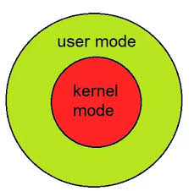
Hardware Protection
The approach taken by most computer system is to provide hardware support that allows us to differentiate among various modes of execution.
Dual-mode operation allows OS to protect itself and other system components.
User mode (1) and Kernel/Monitor/System mode (0)
Mode bit provided by hardware.
Provides ability to distinguish when system is running user code or system code
Some instructions designated as privileged, only executable in system mode
System call changes mode to kernel, return from call resets it to user

Slide 48
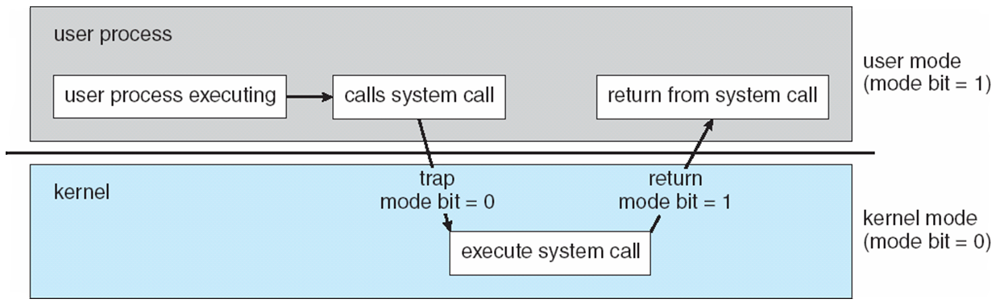
Transition from User to Kernel Mode
With the mode bit, we can distinguish between a task that is executed on behalf of the operating system that is ‘zero’ and ‘one’ is executed on behalf of the user. When the computer system is executing on behalf of a user application , the system is in user mode .
when a user application requests a service from the operating system (via a system call), the system must transition from user to kernel mode to fulﬁll the request. This is shown in his figure.

Slide 49
System Calls
A system call is a way for programs to interact with the operating system.
A computer program makes a system call when it makes a request to the operating system's kernel. System call provides the services of the operating system to the user programs via Application Program Interface(API).
Programming interface to the services provided by the OS
Routines typically written in a high-level language (C or C++)
Note that the system-call names used throughout this text are generic

Slide 50
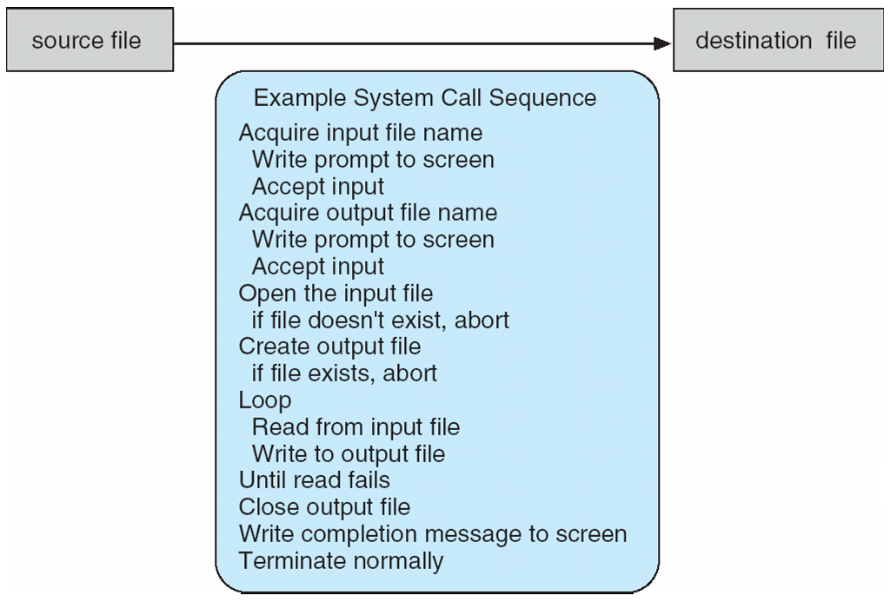
System Calls
System call sequence to copy the contents of one file to another file

Slide 51
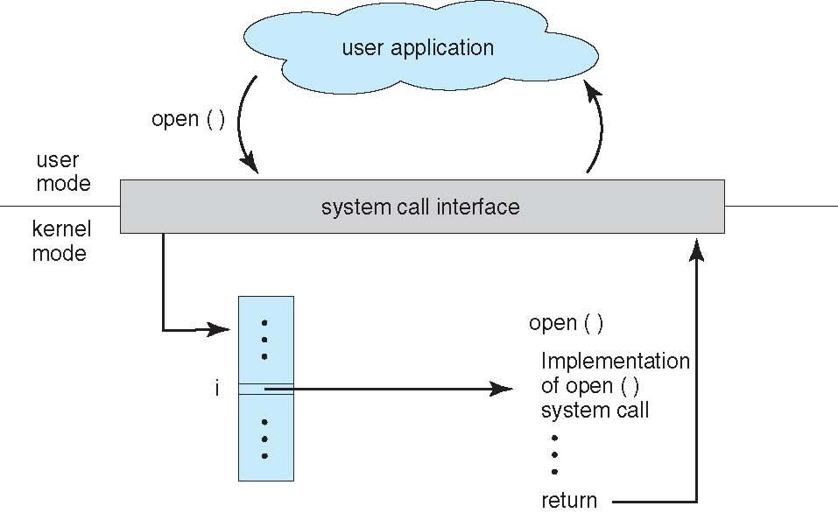
System Call Implementation
Typically, a number associated with each system call
System-call interface maintains a table indexed according to these numbers
The system call interface invokes the intended system call in OS kernel and returns status of the system call and any return values
The caller need know nothing about how the system call is implemented
API – System Call – OS Relationship

Slide 52
A View of Operating System Services

Slide 53
Operating System Services
Operating systems provide an environment for execution of programs and services to programs and users
One set of operating-system services provides functions that are helpful to the user:
User interface - Almost all operating systems have a user interface (UI).
Varies between Command-Line (CLI), Graphics User Interface (GUI), Batch interface- in which commands and directives to control those commands are entered into files, and those files are executed.
Program execution - The system must be able to load a program into memory and to run that program, end execution, either normally or abnormally (indicating error)
I/O operations - A running program may require I/O, which may involve a file or an I/O device

Slide 54
Operating System Services (Cont.)
One set of operating-system services provides functions that are helpful to the user (Cont.):
File-system manipulation - The file system is of particular interest. Programs need to read and write files and directories, create and delete them, search them, list file Information, permission management.
Communications – Processes may exchange information, on the same computer or between computers over a network
Communications may be via shared memory or through message passing (packets moved by the OS)
Error detection – OS needs to be constantly aware of possible errors
May occur in the CPU and memory hardware, in I/O devices, in user program
For each type of error, OS should take the appropriate action to ensure correct and consistent computing
Debugging facilities can greatly enhance the user’s and programmer’s abilities to efficiently use the system

Slide 55
Operating System Services (Cont.)
Another set of OS functions exists for ensuring the efficient operation of the system itself via resource sharing
Resource allocation - When multiple users or multiple jobs running concurrently, resources must be allocated to each of them
Many types of resources - CPU cycles, main memory, file storage, I/O devices.
Accounting - To keep track of which users use how much and what kinds of computer resources
Protection and security - The owners of information stored in a multiuser or networked computer system may want to control use of that information, concurrent processes should not interfere with each other
Protection involves ensuring that all access to system resources is controlled
Security of the system from outsiders requires user authentication, extends to defending external I/O devices from invalid access attempts

Slide 56
End

